Slide 1
Java 9+
The next generation. A whole new world. Not your mama’s Java. 🎉

Slide 2
Intro

Slide 3
Intro
Java 10 was the first of the bi-annual releases
Six-month release cycle means less time for “big” changes
Java 9 started introducing experimental & preview features
Generally used 2 releases to get community feedback before being finalized as a standard

Slide 4
Intro
Language
JDK
Tooling
Runtime
Notes:
Breaking changes for these releases down by category, rather than release

Slide 5
Language
Parlez vous Java?

Slide 6
Language
Enhancements in a nutshell:
Module system
Private interface methods
“Effectively final” in try-with-resources
Type inference
Switch expressions
Text blocks
Pattern matching
Record classes
Sealed classes

Slide 7
Language
Java 9
Java Platform Module System
(JPMS)
Additional loading & scoping capabilities
Encapsulation at the JAR level
New manifest file to declare:
Exported packages
Service implementations
External modules

Slide 8
Language
Java 9
Java Platform Module System
(JPMS)
Multi-release JAR files
JAR files can contain classes specific to a Java release
The module loader will ensure these get loaded before the more general classes
Notes:
For instance, a library can contain three versions of `Foo.class`: one that relies on Java 14 features, one that relies on Java 11 features, and a generic one. The platform will load whichever one is most “compatible”.

Slide 9
Language
Java 9
Java Platform Module System
(JPMS)
Adoption
JDK itself is the primary user
Fully restructured and repackaged as modules
Reception by the general community is lukewarm, adoption slow
Notes:
We’ll also talk about modules later, though a full demo or tutorial is outside the scope of this presentation

Slide 10
Language
Java 9
Private Interface Methods
Private non-virtual methods on interfaces
Interfaces with behavior?! Preposterous!
Only private methods, so of limited use
Think of them as helpers for default methods, a factoring tool
Notes:
Since these private methods can only be used by the actual interface, and not by implementors or extenders, they are just a “factoring” tool, for encapsulating common behavior needed by default methods.

Slide 11
Language
Java 9
“Effectively Final” for try-with-resources
Allows resource variables to be reused
Effectively final: Variable holding resource is not reassigned within try block
Allows using same variable in multiple blocks
Allows declaring the variable before the try-with-resources statement

Slide 12
Language
Java 10
Variable Type Inference
Infer type of local variable from assignment
Variable type inferred from expression on right-hand side
Works in the following places:
Local variables that are initialized where they are declared
Variables declared as part of a for or for-each loop

Slide 13
Language
Java 10
Variable Type Inference
Infer type of local variable from assignment
Similar to Groovy’s def, but variable type is specific
Be judicious – don’t sacrifice readability
Type of right-hand side should be obvious

Slide 14
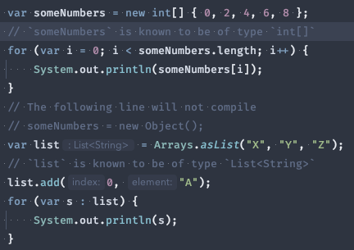
Language
Java 10
Variable Type Inference
Infer type of local variable from assignment

Slide 15
Language
Java 14
Switch Expressions
Use a switch as an expression
Simplifies assigning a value based on a switch
Prevents errors from forgetting to break
Scopes variables to the case, rather than the whole switch block
Existing switch statement remains unchanged
Notes:
Preview started in Java 12, refined in 13, standardized in 14

Slide 16
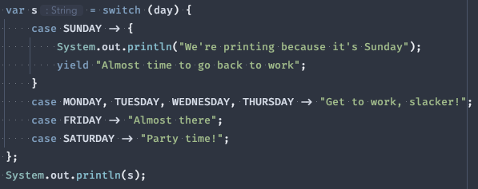
Language
Java 14
Switch Expressions
Use a switch as an expression
Notes:
Preview started in Java 12, refined in 13, standardized in 14

Slide 17
Language
Java 15
Text Blocks
Simpler multi-line string declarations
Declare string literals over multiple lines
Avoids the need for most escape sequences
Provides predictable, controllable formatting
Notes:
Preview started in Java 13, refined in 14, standardized in 15

Slide 18
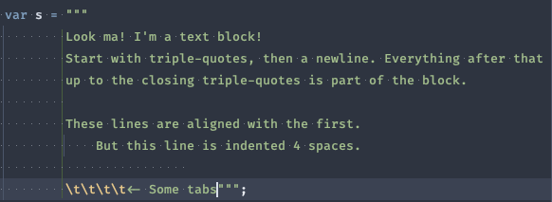
Language
Java 15
Text Blocks
Simpler multi-line string declarations
Notes:
Preview started in Java 13, refined in 14, standardized in 15

Slide 19
Language
Java 15 (preview)
Pattern Matching
Pattern matching for instanceof expressions
Essentially combines the comparison and cast into one expression
New variable of the inferred type is immediately usable
Notes:
Preview started in Java 14 and continued without changes in 15. It is expected to be standardized in 16 (with a couple of minor tweaks).

Slide 20
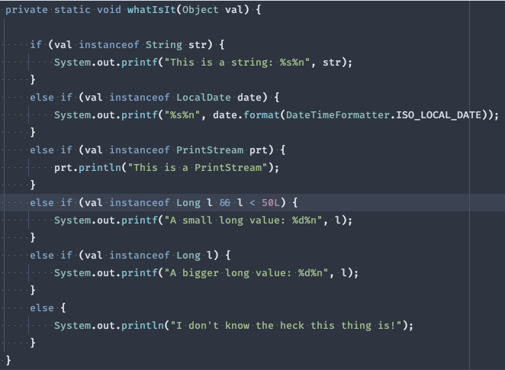
Language
Java 15 (preview)
Pattern Matching
Pattern matching for instanceof expressions
Notes:
Preview started in Java 14 and continued without changes in 15. It is expected to be standardized in 16 (with a couple of minor tweaks).

Slide 21
Language
Java 15 (preview)
Record Classes
Declare simple ‘data holder’ classes
Merge declaration of class, member variables, and constructor
Only a single, “canonical” constructor is allowed
Auto-generates basic Object methods:
equals
hashCode
toString
Notes:
Preview started in Java 14 and continued in 15. Expected to be standardized in 16. Similar in function to Lombok’s @Data annotation

Slide 22
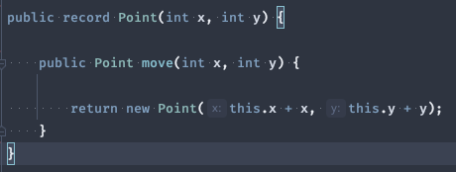
Language
Java 15 (preview)
Record Classes
Declare simple ‘data holder’ classes
Notes:
Preview started in Java 14 and continued in 15. Expected to be standardized in 16. Similar in function to Lombok’s @Data annotation

Slide 23
Language
Java 15 (preview)
Sealed Classes
Allow classes/interfaces to restrict their extenders
Classes declare which other classes may extend them
Interfaces declare which classes may implement them
Provides some safety without declaring a class final
Will support future uses of pattern matching
Notes:
Preview started in Java 15

Slide 24


Language
Java 15 (preview)
Sealed Classes
Allow classes/interfaces to restrict their extenders
Notes:
Preview started in Java 15

Slide 25
JDK
more development for your kit since 1996

Slide 26
JDK
Enhancements in a nutshell
Reactive streams
HTTP client
TLS 1.3
Reimplemented socket APIs
Improved NullPointerException
Modularity and cleanup
Removed modules
Eliminated modules

Slide 27
JDK
Java 9
Reactive Streams
Primitives for reactive programming
Introduces standardized primitives for reactive programming (including backpressure)
Not intended for direct use by consumers
Instead, provides interop between libraries & frameworks that implement the primitives
Notes:
Notable implementers are Akka, Project Reactor, Vert.x, and more

Slide 28
JDK
Java 11
HTTP Client
An HTTP client baked into the standard library
Huge improvement over java.net.URLConnection
Supports HTTP 1.1 & 2.0, TLS
Heavy use of Fluent Builder pattern
Separate module: java.net.http
Not as performant as OkHttp or Apache HttpComponents
Notes:
Due to its performance, probably not the choice for production-grade applications. But a find choice for scripts, prototypes, etc.

Slide 29
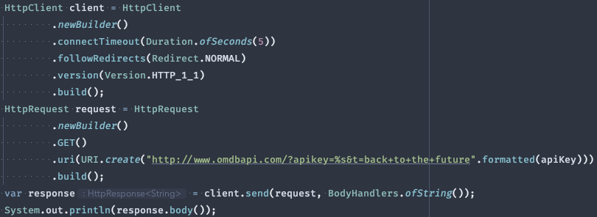
JDK
Java 11
HTTP Client
An HTTP client baked into the standard library

Slide 30
JDK
Java 11
TLS 1.3
Implement the latest TLS standard
Upgrades the Java Secure Socket Extension (JSSE)
Adds support for the TLS 1.3 protocol
Adds new cipher suites required by TLS 1.3
Removes some older, insecure cipher suites

Slide 31
JDK
Java 13 & 15
Reimplement Socket APIs
Reimplement the archaic socket API internals
Previous implementations had been around since 1.0
Brittle & inefficient hybrid Java/C implementation
Insufficient for supporting upcoming JVM enhancements
Java 13: Reimplement TCP sockets
Java 15: Reimplement UDP sockets

Slide 32
JDK
Java 14
Improved NPE
Enhanced NullPointerException error messages
Helps with chains of references or calls
Pinpoints exactly which object was null
Details the operation that was attempted

Slide 33
JDK
Java 9 - 15
Modularity & Cleanup
Modularize the JDK and perform some housekeeping
Split the monolithic JDK into multiple libraries that can be included or excluded from the JVM, as needed
Infrequently-used modules are now excluded by default
Obsolete modules have been completely eliminated

Slide 34
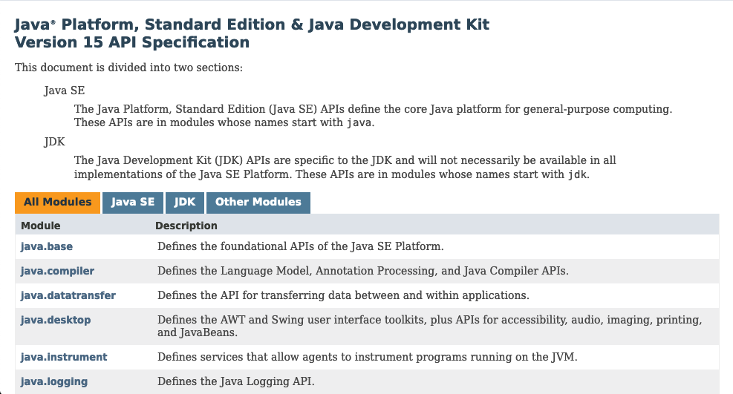
JDK
Java 9 - 15
Modularity & Cleanup
Modularize the JDK and perform some housekeeping
Notes:
The platform Javadoc is now broken down by modules at the top-level. Drill into the module to see the packages available.

Slide 35
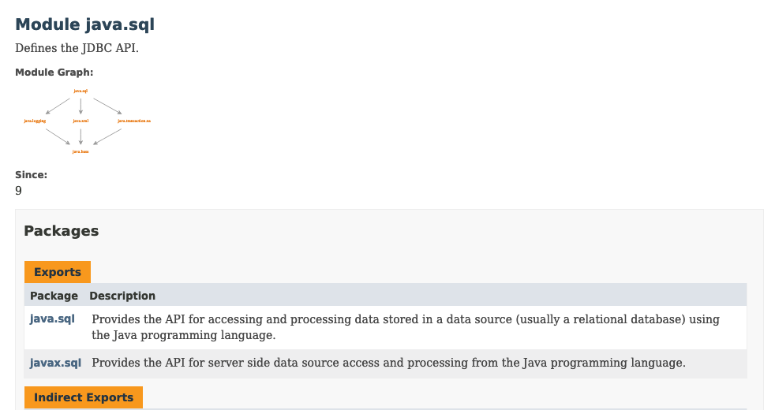
JDK
Java 9 - 15
Modularity & Cleanup
Modularize the JDK and perform some housekeeping
Notes:
Note the “module graph” at the top of the module documentation. this shows the module’s imports (dependencies) and exports.

Slide 36
JDK
Java 9 - 15
Modularity & Cleanup
Modularize the JDK and perform some housekeeping
Removed:
JavaFX (11)
Java EE (11)
CORBA (11)
Nashorn JavaScript engine (15)

Slide 37
JDK
Java 9 - 15
Modularity & Cleanup
Modularize the JDK and perform some housekeeping
Eliminated
JavaDB
Java Applets
Java Web Start

Slide 38
Tooling
All I see is nails…

Slide 39
Tooling
Enhancements in a nutshell:
Module system
jlink
Javadoc
JShell
Ahead-of-time compilation (GraalVM)
Shell scripts
Flight Recorder

Slide 40
Runtime
Is anyone even reading these?

Slide 41
Runtime
Enhancements in a nutshell:
Module system
Performance improvements
Garbage collection
Thread management
Unicode
Hidden classes

Slide 42
Epilogue
To summarize, in conclusion, wrapping up…

Slide 43
Epilogue

Slide 44
Epilogue
What’s next?
Project Loom – Lightweight threads, called “fibers”
Project Valhalla – Value types, with efficient memory layout and no identity (midway between primitives and objects)
Project Panama – Better native interoperability
Notes:
My hope is that Loom introduces a language-level (or at least, JDK-level) mechanism for message passing, a la Akka’s Actors or Go’s goroutines & channels.

Slide 45

Q & A

